Slide 1
Melli2s
Making Lifestyle Change Manageable

Slide 2
The Problem
Excuses are endless...
”I don’t have time, Healthy foods are expensive, I can’t do this change alone, I don’t like physical activity, I don’t like healthy foods＂
Patient desires that aren’t met
Accessibility
Affordability
Affirmation
Self-management & Control
Target Market
Need for education
Why is it important to eat healthy?
What are the complications of T2D?
Why is medication necessary?
What are the side effects of the medication?
86 M prediabetic
23.1 M diagnosed T2D
81% has a smartphone
33% Amazon Prime member
109.1 * 81% * 33% = 29.2 M patients
Issues
Patients
Physicians
Society
Stress & depression
Complications of T2D
Longer hospitalization
Expensive medical bills
Patience
No-show of patients
Treatment problems
- Cost
- Increased burden of disease
- Longer hospitalization

Slide 3
Our Solution
DIET
EXERCISE
Overview of progress
Meal planning
Kcal intake and meal overview
Glycemic Index Foods
Glycemic index Scanner
Overview of progress
Self-Reported Fitness
Find a Workout Buddy
Challenges
ClinicalTrials
Melli2s
MEDICATION
VITALS
Overview of compliance
Medication Plan
Checklist (meds today)
Symptoms experienced
3 months statistics
Glucose level
Blood Pressure
Notes:
Other features:
Community to chat with other T2D people

Slide 4
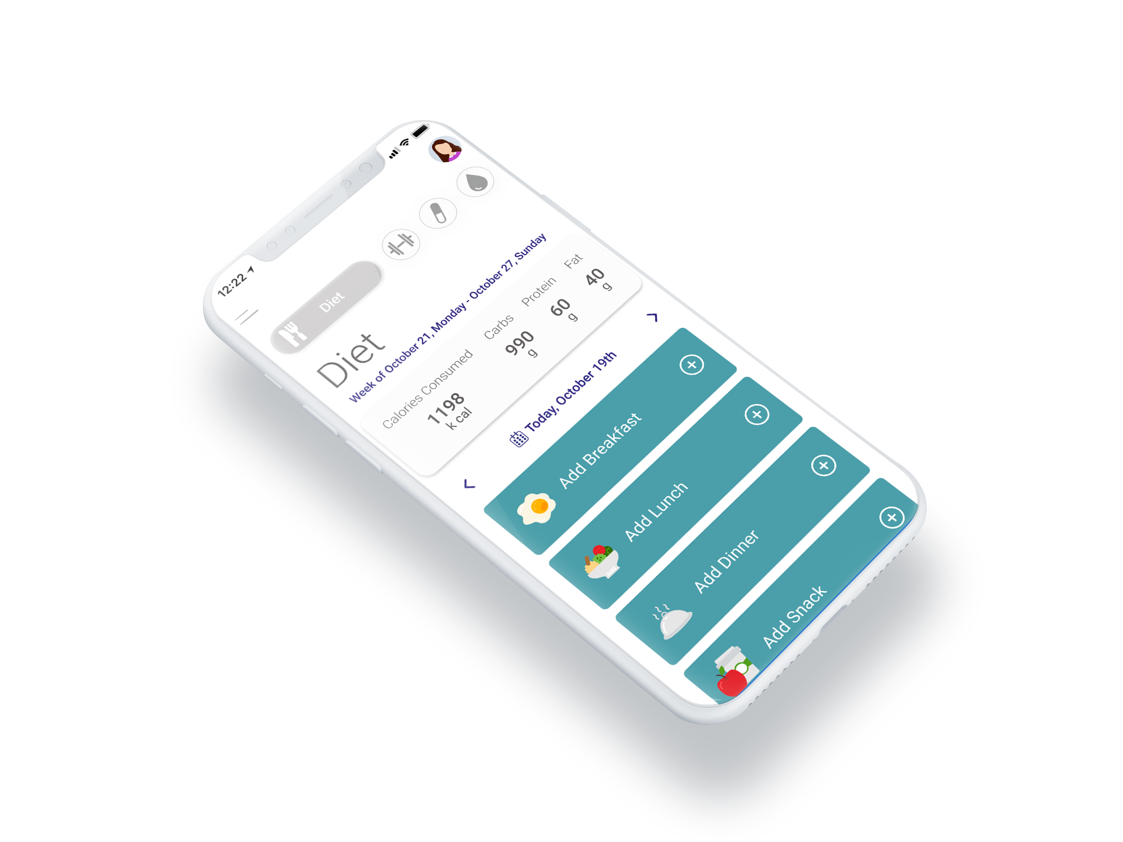

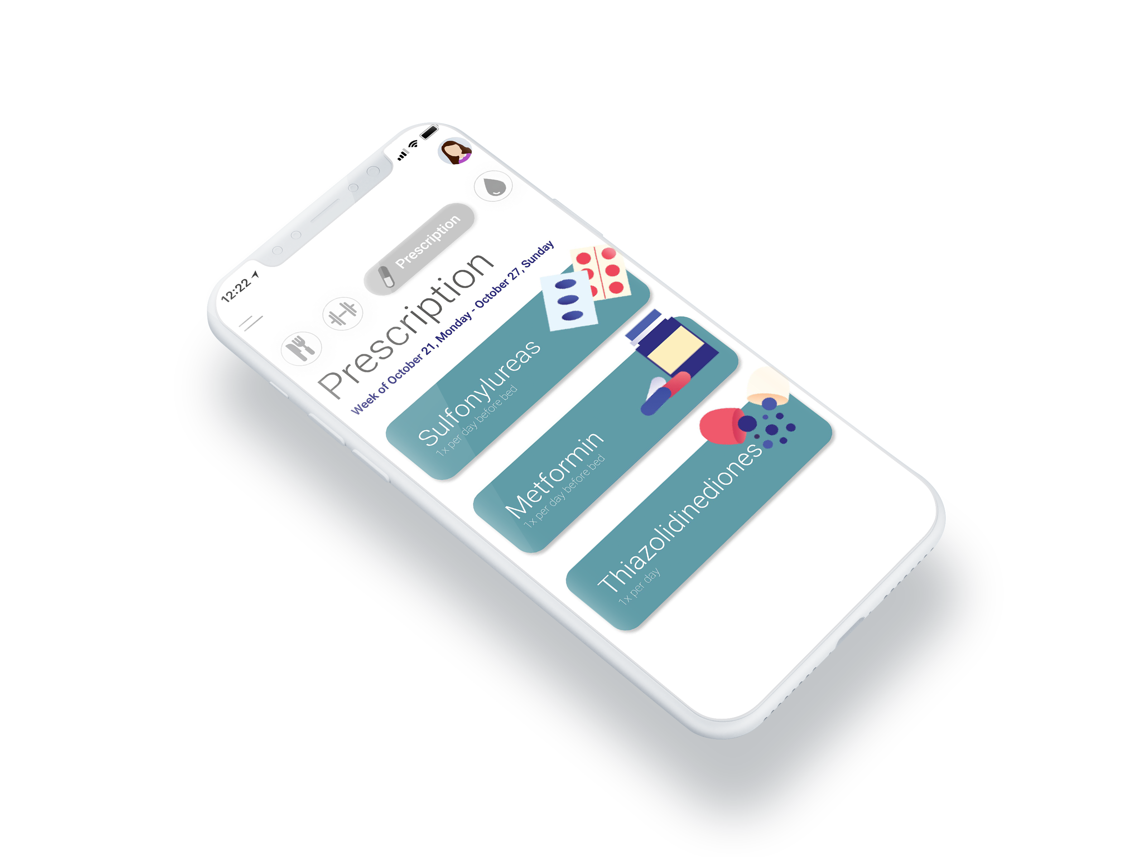
Prototype

Slide 5
Why use our solution?
All-in-one
Feasibility
Fit
Cost
Win-Win
Notes:
Relevance: Some studies have found improve­ments in HbA1c, body weight and health behaviour through the use of apps. Our solution has different options of exercise and diet that will target a broader market yet still making it

Slide 6















Tech Stack

Slide 7
Appendix 1: Competitive Analysis
 | Exercise | Diet | Vitals | Medication | Amazon food | Fitness Buddy | Price
Fooducate |  |  |  |  |  |  | Free
MySugr |  |  |  |  |  |  | Free
BG Monitor Diabetes |  |  |  |  |  |  | Free
Health2Sync |  |  |  |  |  |  | Free
Glucose Buddy |  |  |  |  |  |  | Free
Diabetes Connect |  |  |  |  |  |  | Free
Diabetes:M |  |  |  |  |  |  | Free
Source: https://www.healthline.com/health/diabetes/top-iphone-android-apps#fooducate

Slide 8
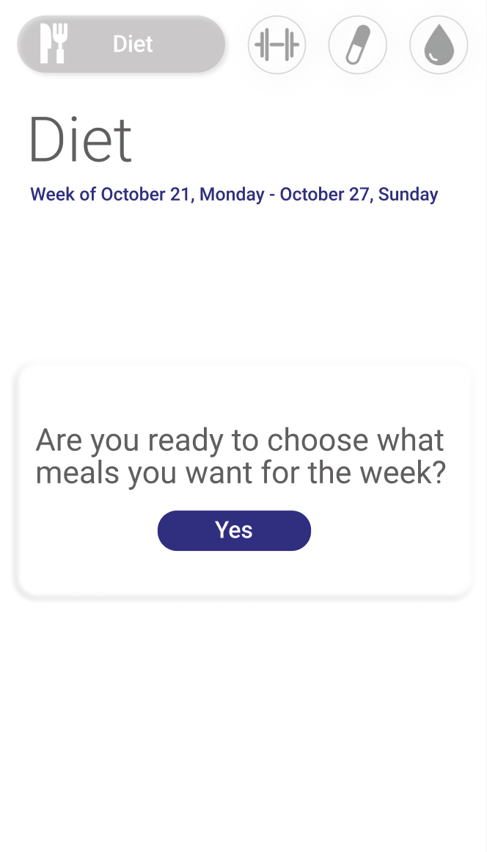
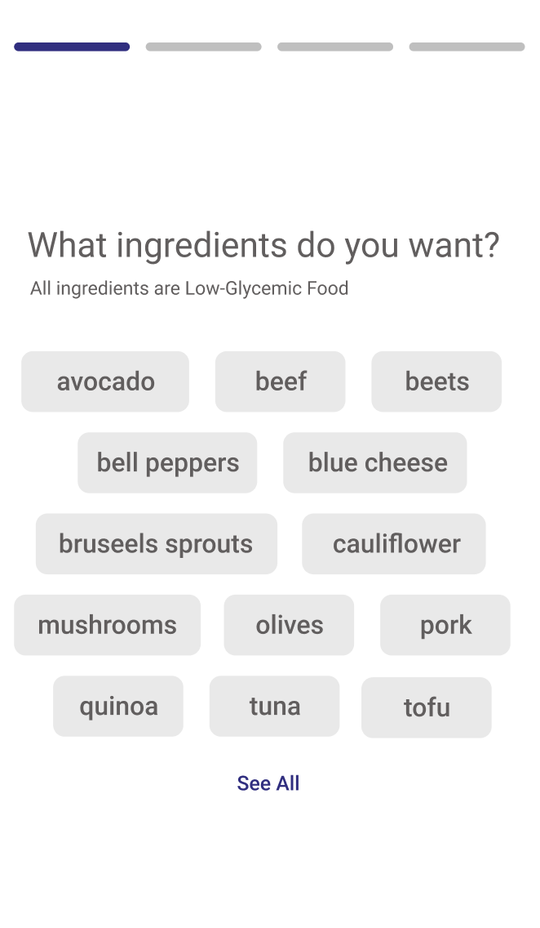
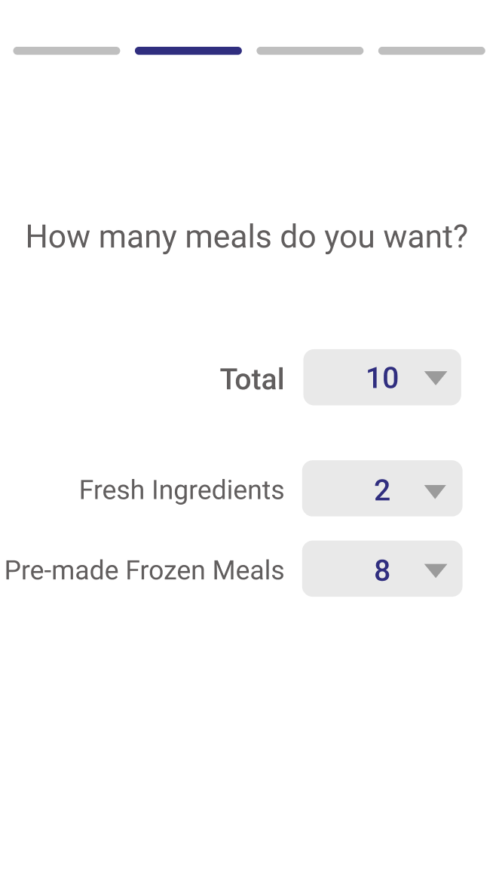
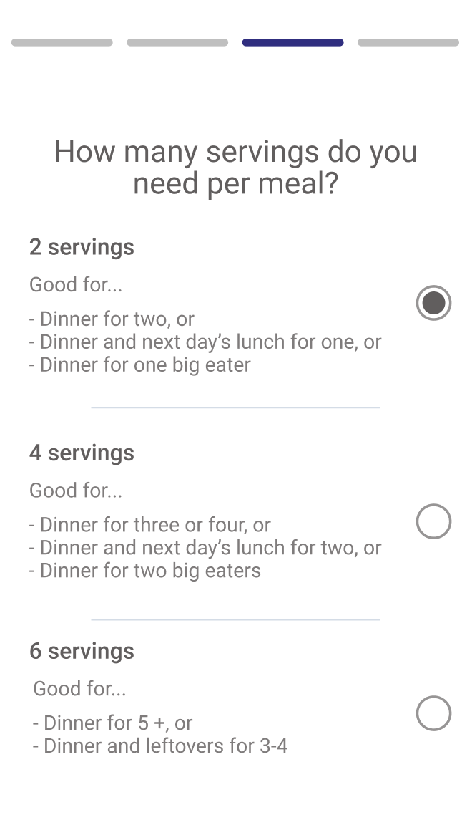
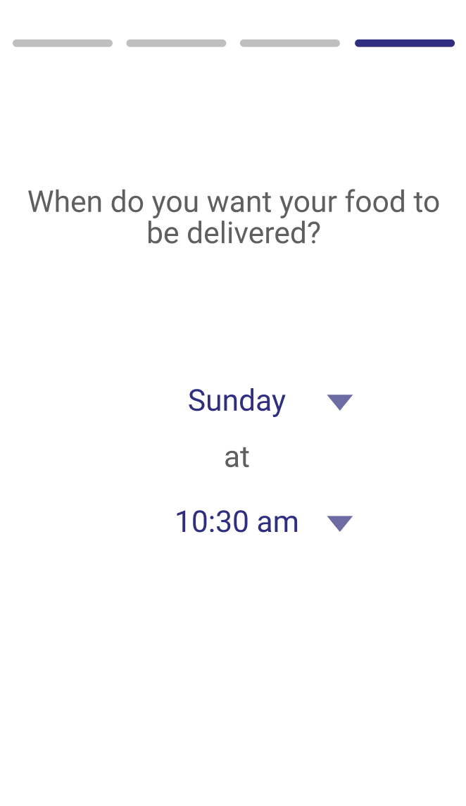
Appendix 2: Example with Diet

